Slide 1
Changing Epidemiology and Pitfalls in the Management of
Dengue Syndrome
Professor Quazi Tarikul Islam
FCPS, FRCP(Edin. Glasg.), MACP
Professor of Medicine
Editor in Chief
National Guideline for Clinical management
of Dengue Syndrome 2018

Slide 2
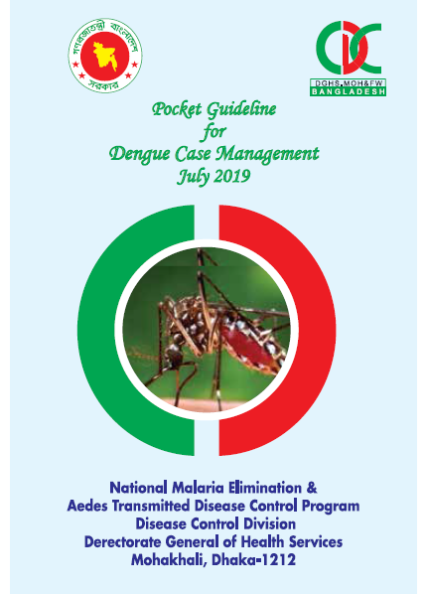
New guideline 2018
Pocket guideline 2019

Slide 3
Epidemiology-Dengue Fever
Ae. aegypti
Humans
Dengue Virus

Slide 4
Dengue Dengue : South Asia 2019
Philippines : 3,22,693 cases, 1272 deaths as of 28 October, 2019
Malaysia: 1,02,734 cases, 149 deaths as of 28 October, 2019
India: 11,808 cases, 4 deaths as of 26 September, 2019
Vietnam : 1,24,751 cases, 15 deaths as of 28 October, 2019
Thailand: 44,671 cases, 62 deaths as of 16 July, 2019
Singapore: 12,293 cases as of 28 October, 2019
Sri lanka : 234,078 cases, 47 deaths as of 5 Aug, 2019
Source: WHO

Slide 5
DenguDengue: Bangladesh (1, January to 28, October) Source : Dengue: Bangladesh (1, January to 1, December 2019) Source : DGHS
People affected by dengue
Released from hospitals
100201
99,512

Slide 6
Dengue: Bangladesh (1, January to 1, December, 2019) Source : DGHS
Official death
129
Unofficial death
248

Slide 7
The spread of dengue has become a major public health concern in recent times due to alarming climate change
Using country level panel data over the 2000–2017 period, it has been confirmed that climate change and socio-economic variables on the incidence of dengue-borne diseases in some of the most highly vulnerable countries
Climate change is one of the worst global threats ever faced in human history
Watts, N.; Adger, W.N.; Agnolucci, P.; Blackstock, J.; Byass, P.; Cai, W.; Grace, D.; Li, M.; Yu, C.; Yin, Y.; et al. Health and climate change: Policy responses to protect public health. Lancet 2015, 386, 1861–1914

Slide 9
Vector Life-cycle (10-12days)
Black and oval in shape
Laid singly above water surfaces of containers
Without float
Viability: 6 months to 1 year due to the presence of chorion
Feeding stage
Breeds in clean and non- polluted water
Short and stout siphon with one pair of hair tuft
Rests at an angle to the water surface
Non-feeding stage
Breeding trumpet is long,
slender with narrow opening
Egg
Lar)va(2-3days
Pupa(6-8days
Adult-1-2days
Maxillary pulps shorter than probosis
Wings uniformly grayish black -Body and legs are black with distinctive white patches throughout
Thorax has marking

Slide 10
The duration of developmental times
31.0-32.0 days at 15℃
13.9-16.6 days at 20℃
10.2-11.8 days at 25℃
7.4-8.2 days at 30℃
Ae. aegypti strains averaged

Slide 11
Cont.
Ae. albopictus
12.6-15.1 days at 20℃
10.0-11.7 days at 25℃
7.6-8.4 days at 30℃
The developmental zero was 4.2-8.2℃

Slide 12
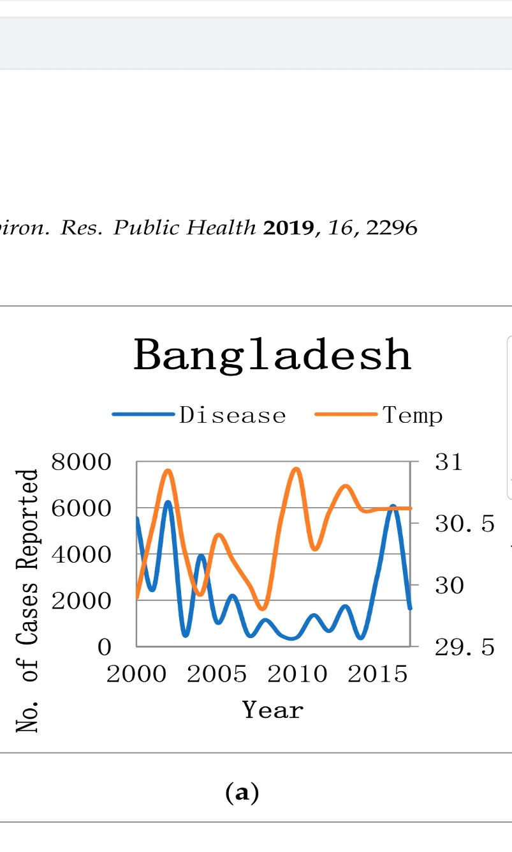
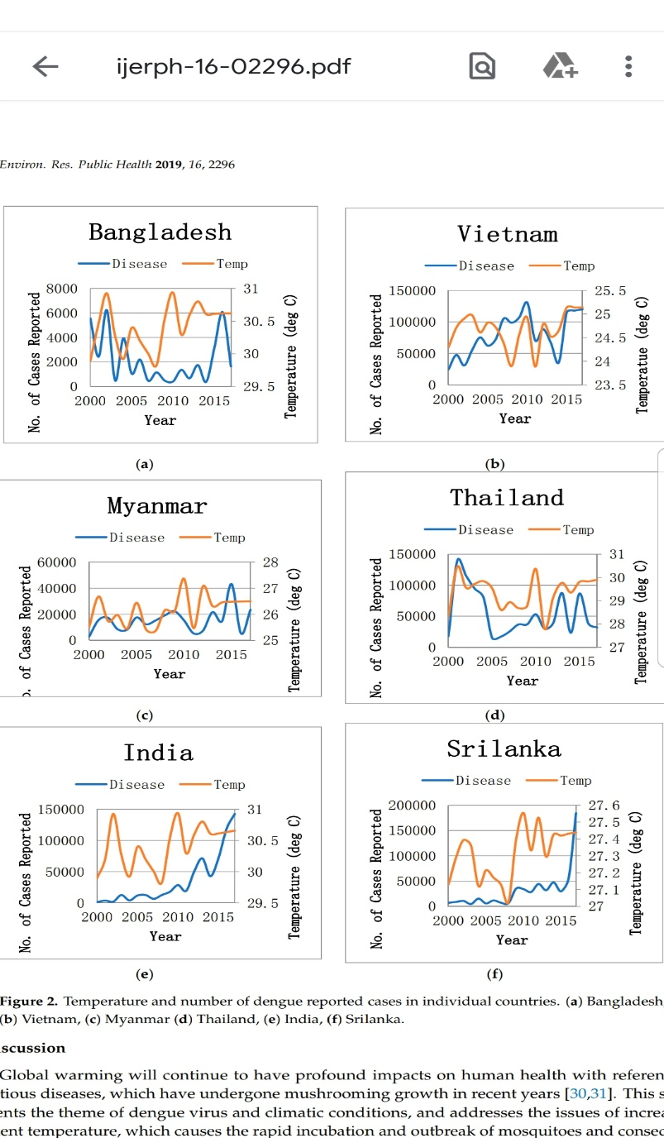
Int. J. Environ. Res. Public Health 2019, 16, 2296

Slide 14
Climate Change
leads to an increase in sea-surface temperatures.
It weakens the trade winds in the regions and causes heavy rainfall, floods or droughts in different regions of the World
La Niña episodes represent periods of below-average sea surface temperatures across the east-central Equatorial Pacific.
Global climate La Niña impacts tend to be opposite those of El Niño impacts. In the tropics, ocean temperature variations in La Niña also tend to be opposite those of El Niño
The El Niño-Southern Oscillation (ENSO), an ocean-atmosphere phenomenon of the Pacific Ocean with a semi-periodic multi-annual cycle , has been hypothesized to be a driving force behind the dengue epidemics in regions at risk through its profound influence on the local climate

Slide 15
Empirical analysis shows a positive association between climate and socioeconomic conditions in the advent of Dengue borne diseases. We find that climate change, as measured by temperature, is proactively contributing to spread of Dengue
Anwar A, Khan N, Ayub M, Nawaz F, Shah A, Flahault A: Modeling and Predicting Dengue Incidence in Highly Vulnerable Countries using panel data approach; Int. J. Environ.Res. Public Health 2019, 16,2296;doi10.3390/ijerph16132296

Slide 16
Cont.
Higher air temperature facilitates the transmission of dengue by increasing the replication rate of the dengue virus in Aedes aegypti and the blood-feeding behavior of the mosquito vector.
A non stationary association between El Niño dynamics and monthly dengue hemorrhagic fever incidence was also shown in the Bangkok area of Thailand from 1986 to 1992 .

Slide 17
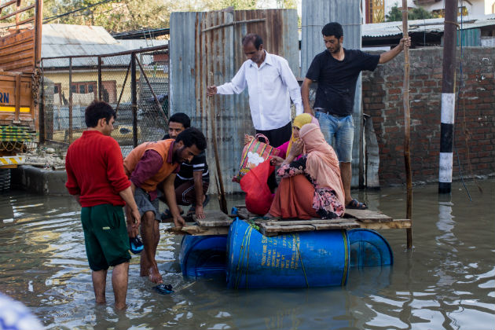
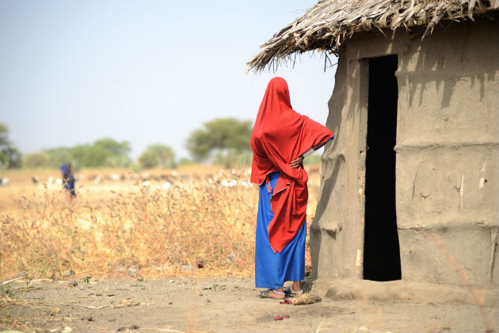
Effect of Climate Change

Slide 18
Dengue fever and dengue haemorrhagic fever epidemiological changes

Slide 19
Changing Epidemiology
The epidemiology of DF/DHF is complex and remains poorly understood. It involves
host, viral and vector status
that are further influenced by
demographic, economic, behavioral and
varied societal factors.

Slide 20
1.Changes in human host
A. Shift in affected-age group:
In South-East Asian countries, Dengue was the disease of children. DHF/DSS in these areas occurs mostly in children aged 2-15 years.
However, there is an evidence of increase of dengue incidence in older age groups, and this age shift has been reported in Singapore, Indonesia, Bangladesh and Thailand
Bhatia R, Dash AP, Sunyoto T. Changing epidemiology of dengue in South-East Asia. WHO South-East Asia J Public Health 2013;2:23-7

Slide 21
B. Sex differences:
South-East Asia region suggest higher ratio of males than females in DF/DHF hospitalized cases (India, Bangladesh, Singapore and Malaysia).
A higher rate of mortalities among females than males, suggesting different pathogenesis processes or immune response.

Slide 22
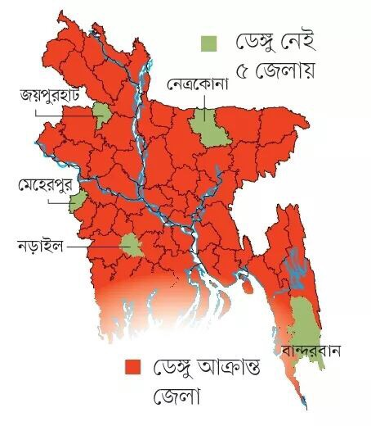
C. Rural expansion:
It is no more a disease of Urban only.

Slide 23
2.Changes in the dengue virus
A. Virulence affecting severity of the disease :
Sequential infections or secondary infections are important to determine the severity of the disease.
In Thailand following quantum of DHF risk with different sequences of dengue viruses with
DENV-1/DENV-2: 500-fold,
DENV-3/DENV-2: 150-fold
DENV-4/DENV-2 50-fold risk.
The infection enhancement contributes to the pattern of variable outbreak

Slide 24
Virulence of the circulating virus is hypothesized to play a role in disease severity, and small genotypic changes in dengue viruses could lead to DHF emergence, as reported from a
Sri Lankan study.

Slide 25
B. Genotype affecting time interval between sequential infections :
There seems to be no time limit to sensitization after a primary infection.
Long-interval secondary infection resulted in decreased neutralizing
antibody from the primary infection, thus accounting for DHF/DSS in adults.

Slide 26
Reported Dengue Cases and Deaths, Bangladesh: 2000 – 2018

Slide 27
Largest dengue outbreak of the decade with high fatality may be due to reemergence of DEN-3 serotype in Dhaka, Bangladesh, necessitating immediate public health attention
T shirin et al , © 2019 The Author(s). Published by Elsevier Ltd, NMNI, 29, 100511
This is an open access article under the CC BY-NC-ND license (http://creativecommons.org/licenses/by-nc-nd/4.0/).

Slide 28
3.Changes in the vector bionomics
A. Rural spread: Rural area become more urbanized.
B. Seasonality and climate variability:
Early prolonged interrupted rain is the prime issue.
Ae. aegypti is a hygrophilic (humidity-loving)
C. Socio-cultural and socio-economic factors affecting vector longevity and survival.
Changing pattern of dengue transmission.

Slide 29
Prediction and Future
Future Epidemics:
Hoping for “a regional, systematic process of disease monitoring and prediction, “we’re much better at predicting climate and weather than we are at predicting diseases. As there is link between El Nino and Dengue, climate data can really help us predict disease better.”

Slide 31
Management pitfalls in Dengue syndrome

Slide 32
Pitfalls
What is Pitfall ?
A hidden or unexpected/unsuspected danger/difficulty
Synonym/ Similar:
Hazard/Danger/Risk/difficulty/issue/problem/drawback

Slide 33
Pitfalls in Dengue
Pitfalls in Dengue can be categorize in following :
Pitfalls in Clinical Features
Pitfalls in diagnosis
Pitfalls in management
Pitfalls of uncovered/unknown situations of DF

Slide 34
Dengue Case Group (200 data)

Slide 35
Pitfalls in C/F
Afebrile DF: A few patient of DF entered at plasma leakage even without any evidence of fever. (These patients are usually elderly and present with body aches)
TT become less sensitive: TT become less sensitive to detect covert hemorrhage. Even with very low platelet count it is negative.
Rash: Typical DF rash was almost rare finding in 2019. Rather convalescent rash present during recovery phase.
Early plasma leakage: Many patients entered into plasma leakage very early of disease process (before the critical phase).

Slide 36
Pitfalls in C/F
Prologed Fever: In 2019 typical pattern of DF is changed. Highest recorded temperature was 106$℉$. Many patient had very high temperature even after 5/6 days.
Persistent vomiting : persistent vomiting during starting of fever indicate worse course.
Abdominal pain: Abdominal pain was a frequent finding in 2019.

Slide 37
Onset of afebrile day (200)

Slide 38
Pitfalls in C/F
Abdominal distension: Abdominal distension very common finding with positive shifting dullness even in the 2nd/3rd day of illness .
Respiratory distress: Very common. If no previous obstructive lung diseases are known check for pleural effusion (exclusively on right side) or Pneumonia

Slide 39
Pattern of C/F 2019

Slide 40
Special findings (200 cases)

Slide 41
Pitfalls in diagnosis:
About NS1
False positive ------- 5%
False negative---- 5%
So, emphasis on clinical presentation needed.
False negative percentage of DF cases is rising may be due to change in virulence of Dengue Virus or diagnostic kits standard.

Slide 42
About NSI
Overall sensitivity of NS1 Ag detection kit varied widely. Sensitivity was highest in patients sampled during the first 3 days after onset of fever,
In asymptomatic patients, RT-PCR assay has proved to be more sensitive than NS1 antigen detection.
The NS1 antigen level correlated significantly with viraemia and a low NS1 antigen ratio was associated with more severe disease.

Slide 43
BMC Infectious Diseases volume 6, Article number: 120 (2006)

Slide 44
The examination of paired serum samples is considered the most reliable sero-diagnostic procedure for dengue.
However, if only one blood sample is available, a single positive ELISA-result carries a high rate of false-positivity and should be confirmed using a second and more specific diagnostic technique.

Slide 45
Doing NS1 test after 5 days and IgM before 7 days is absolutely a wrong information for the doctors.
In the absence of further testing, platelet and white blood cell counts are helpful for the correct interpretation.
Data from 200 cases shows 15% of Dengue patients had NS1 negative

Slide 46
Pitfalls in diagnosis:
Complete Blood Count(CBC)
Presenting with severe Leucopenia progress to plasma leakage more rapidly and may have a worst clinical course.
Rapid fall of platelet does not always correlate with positive TT
HCT > 48 needs urgent fluid management
HCT <30 needs to check internal bleeding
Dengue fever with leukocytosis need to consider pancreatitis/pneumonia/Infective Colitis

Slide 47
Pitfalls in diagnosis:
Dengue serology
IgG positive during febrile illness patient needs special consideration and attention as this could be secondary infection.

Slide 48
Pitfalls in diagnosis:
Radiology
USG of W/A : To detect
Fluid collection (Ascites)
Splenomegaly
Hepatomegaly
Thickened gallbladder
CXR P/A view: Fluid accumulation (Pleural effusion)
Pneumonitis

Slide 49
Pitfalls in diagnosis:
Other Tests
Blood C/S – If Fever persist more than 5 days
Lipase – If abdominal pain persists to exclude acute pancreatitis
Stool R/E – If loose motion persists more than 4/5 days.
S. Creatinine and electrolyte – If feature of AKI presents or profound loose motion and vomiting.

Slide 50
Management Pitfalls

Slide 51
Group A& B usually do not develop acute situations.
Group B with warning signs and group C demand special attention for management.
Usually Group C patients need special attention and frequent monitoring with taking decision about special fluid management.

Slide 52
Patients Group C:
Severe plasma leakage leading to dengue shock and/or fluid accumulation with respiratory distress.
Severe organ impairment (hepatic damage, renal impairment) Myocarditis, cardiomyopathy, encephalopathy or encephalitis.
Severe metabolic abnormalities (metabolic acidosis, severe Hypocalcaemia etc.).

Slide 53
Decompensated Shock
Characterized by DSS + profound hypotension
Preferably this group of patient need to manage in ICU setting
If ICU setting is not available at this moment management should be at the spot with out referral to any other hospital because one second counts.

Slide 54
Fluid overload
All hypotonic solutions should be stopped.
Switch from crystalloid to colloid solutions as bolus fluids.
If the patient is in shock, together with fluid overload 10 ml/kg/h of colloid (dextran/plasmasol) should be given.
Intravenous Frusemide should be administered if the patient has stable vital signs.

Slide 55
Fluid in Dengue management

Slide 56
Fluid
Inappropriate fluid infusion can lead to
1. Over hydration( volume overload) -Pulmonary edema- Death
2. Under hydration – Prolonged shock – Organ failure -- Death

Slide 57
Attention
Excessive fluids during the recovery phase may cause hypervolemia, pulmonary edema, or heart failure.
An extremely important point is that a drop in the hematocrit level at this stage should not be taken as a sign of internal hemorrhage.
A strong pulse and blood pressure with a wide pulse pressure and diuresis indicate good vital signs.

Slide 58
When rapid correction by fluid is needed :
Impending Shock / Shock
High HCT
Narrow pulse pressure (<20)
If SBP < 100 mm Hg --- 400ml – 500ml Crystalloid running
If BP not raised give 2nd bolus dose of crystalloid ,then colloid
Target: BP : SBP >110 and Check interval of urine output.

Slide 59
About Colloids
Dextran / Plasmasol (easily available safe to use)
Hemaceel
Plasma Blood & Blood Components
Human Albumin

Slide 60
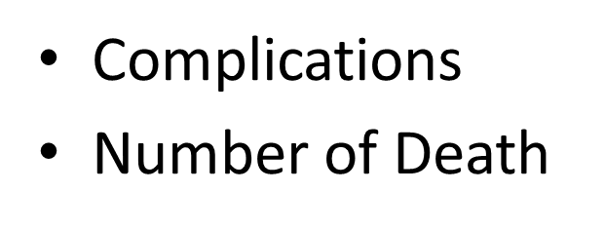
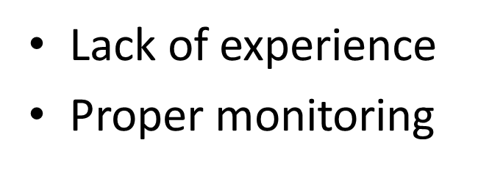
Clinical Judgment and monitoring

Slide 61
Justified Use of Colloid and how ?
Signs of volume overload but gross hypotension is present:
Persistent High HCT, despite adequate crystalloid infusion.
Always give in a bolus dose :
10 ml/Kg/hr for children at a time
500ml/ hr for adult at a time
HCT before and after should be checked

Slide 62
Platelet transfusion in Dengue Fever
Platelet concentrate transfusion is not required even in patient having count less than 5000/mm3
Apheretic platelet transfusion is better than multiple concentrate (PRP)
Prophylactic platelet transfusion is contraindicated and can lowers further platelet count

Slide 63
Blood transfusion
Injudicious blood transfusion causes pulmonary edema which may be life threatening. Except in-
Excessive visible bleeding
Rapid fall of HCT ( concealed bleeding)

Slide 64
Excessive Menstrual Bleeding
Dengue Fever may cause early date menstruation / prolongation of usual menstrual period. Sometimes difficult to manage
better outcome with short term hormonal therapy
Judicious use of whole blood / platelet if needed

Slide 65
Pitfalls of uncovered/unseen situations of DF
DF with co-infection
HLH

Slide 66
Dengue with Co-infection
Needs more documentation. Needs to find correlation –
1. Enteric Fever :
Fever persisting more than 7 days with Splenomegaly clinically/ Sono graphically should be considered Enteric Fever. Blood C/S is recommended if fever lasting more than 5 days .
2. Pneumonia:
Fever with respiratory findings (Cough, crackles ,effusion, bronchial breath sound etc) need to evaluate for pneumonia.
3. Infective diarrhea: Loose motions is very common presentation in Dengue. Loose motion with blood needs to consider about infective diarrhea. Stool R/E and C/S advised.

Slide 67
About HLH
Haemophagocytic lymphohistiocytosis (HLH) is rare but potentially fatal severe immune activation syndrome caused by proliferation of activated lymphocytes and macrophage which leads huge cytokine release syndrome.

Slide 68
HLH (Diagnostic Criteria)
Five of the following eight findings:
Fever ≥38.5°C
Splenomegaly
Bicytopenia
Hypertriglyceridemia and/or hypofibrinogenemia
Hemophagocytosis in bone marrow, spleen, lymph node, or liver
Low or absent NK cell activity.
Ferritin >500 ng/mL.
Elevated soluble CD25.

Slide 69
Prognosis Prediction

Slide 71
Thank You

